Slide 1

ECE 4099 – Capstone Project CAN (Controlled Area Network) Protocol In Medical Instrumentation
K MANOJ MADHAV – 15BEC1078

Slide 2
What is CAN?
A Controller Area Network (CAN bus) is a robust vehicle bus standard designed to allow microcontrollers and devices to communicate with each other in applications without a host computer.
It is a message-based protocol, designed originally for multiplex electrical wiring within automobiles to save on copper, but is also used in many other contexts.

Slide 3
Why CAN Protocol?
Network multiple microcontrollers with 1 pair of wires.
Allow microcontrollers to communicate with each other.
High speed, real-time communication.
Provide noise immunity in an electrically noisy environment.
Low cost

Slide 4
CAN History
First idea - The idea of CAN was first conceived by engineers at Robert Bosch in Germany in the early 1980s.
Early focus - develop a communication system between a number of ECUs (electronic control units).
New standard - none of the communication protocols at that time met the specific requirements for speed and reliability so the engineers developed their own standard.

Slide 5
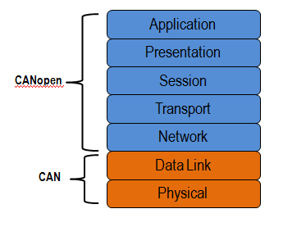
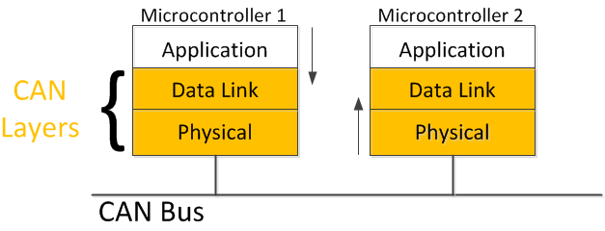
CAN Execution
CAN in OSI Layers
CAN Protocol b/w 2 µCs

Slide 6
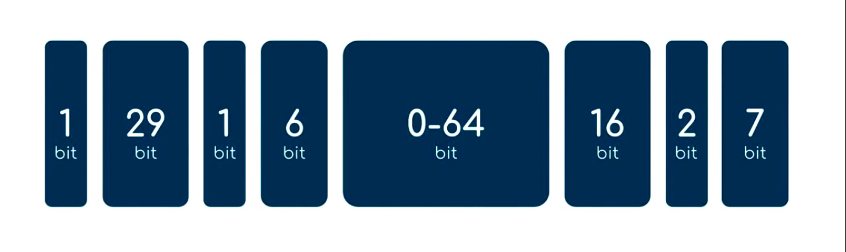
CAN Message
1 bit – Start Of Frame (0 when Transmitting)
29 bit – CAN ID (Functional Addr and Message Priority)
1 bit – RTR (Remote transition Request)
6 bit – Control (provides length of Data)
0-64 bit – Data
16 bit – CRC (Cyclic Redundancy Check)
2 bit – Acknowledgement (Indicates status of CRC)
7 bit – End Of Frame
= 126 bits message (In Total)

Slide 7
CAN in Medical Instrumentation?
Prioritising the messages obtained from various µCs.
Making outsourcing of various internal parts simpler.
Standardised Communication Protocol for systems containing multiple-controllers.
Integrity of message received due to CRC.
Simple implementation of CAN Comm. Protocol.

Slide 8


